Slide 1
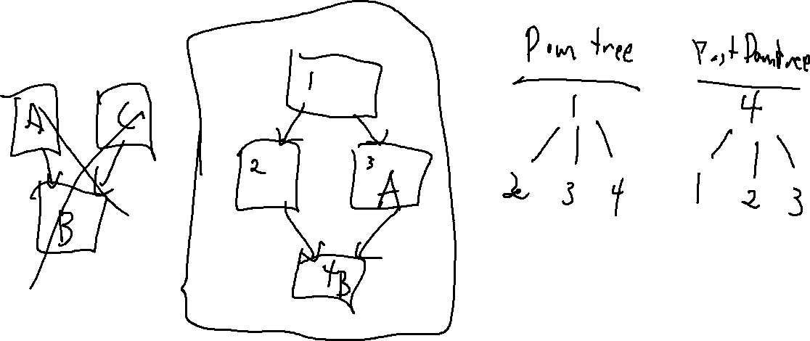
Exercise 18
Dependence Graph Review
Write your name and answer the following on a piece of paper
Give an example of a control-flow graph and indicate a block pair A,B such that A is an immediate forward dominator of B but A does not dominate B

Slide 2
Exercise 18 Solution
Dependence Graph Review

Slide 3
Administrivia and
Announcements

Slide 4

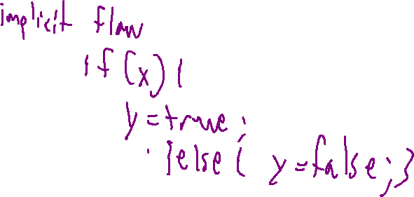
Last Time: Control Dependence
Review: Last Lecture
Focus the analysis on what we care about
Control Dependence Graph (CDG)
Shows what program statements most immediately decide which others execute

Slide 5
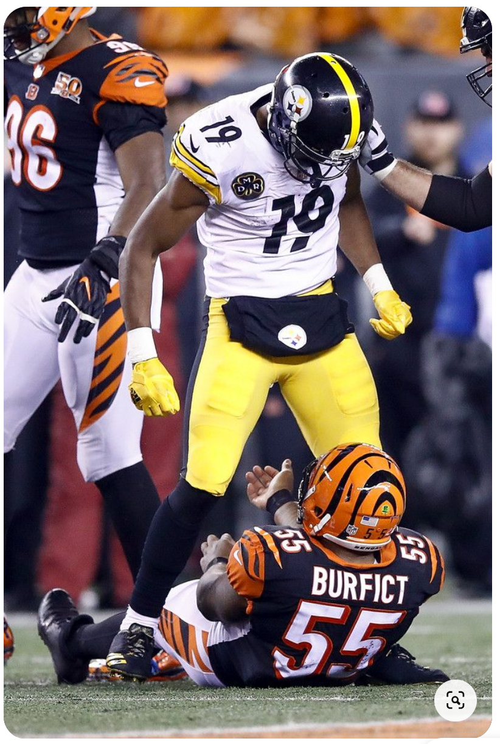

DOM/FDOM Intuition
Review: Last Lecture
Domination Intuition
Forward Domination Intuition
DOM(X,Y) – Paths to Y must go through X
FDOM(X,Y) – Paths from X must go through Y
You cannot get to Y without going through X
You cannot avoid Y after going through X
X “guards” Y
X “is destined for” Y

Slide 6
Immediacy
Review: Last Lecture
Immediate
Immediate
Domination Intuition
Forward Domination Intuition
I
I
FDOM(X,Y) – Paths from X must go through Y
DOM(X,Y)– Paths to Y must go through X
with no intervening node that paths must go through to Y
With no intervening node that paths must go through from X
X “is the closest guard of” Y
X’s “first guaranteed successor is” Y

Slide 7
Control Dependence Intuition
Review: Last Lecture
We’d like to express that getting to Y depends on what happens in X
Y CD X ⇔ there is a CFG-path from X to Y omitting IFDOM(X)
It’s possible to get from X to Y
But it’s not guaranteed

Slide 8
Control Dependence Graph
Dependence Graph Review

Slide 9
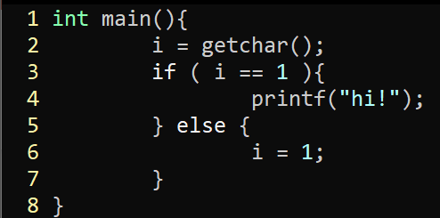
Bonus Exercise
Dependence Graph Review
Draw the Control Dependence Graph for the following program

Slide 10

Bonus Exercise
Dependence Graph Review
Draw the Control Dependence Graph of Basic Blocks for the following program
entry
L₂
L₃
L₄
L₆
exit
Y CD X ⇔ there is a CFG-path from X to Y omitting IFDOM(X)

Slide 11

Bonus Exercise
Dependence Graph Review
Draw the Control Dependence Graph of Basic Blocks for the following program
CFG
Postdom tree
entry
exit
IFDOM(entry, L₂)
L₂
L₃
L₆
IFDOM(L₂, L₃)
L₄
IFDOM(L₃, exit)
L₃
IFDOM(L₄, exit)
L₂
IFDOM(L₆, exit)
L₄
L₆
entry
exit
Y CD X ⇔ there is a CFG-path from X to Y omitting IFDOM(X)

Slide 12

Bonus Exercise
Dependence Graph Review
Draw the Control Dependence Graph of Basic Blocks for the following program
entry
Y
X
L₃ CD L₂ ?
entry
L₂
IFDOM(entry, L₂)
Path(X, Y) omitting IFDOM(X)
IFDOM(L₂, L₃)
Path(L₂,L₃) omitting IFDOM(L₂)
IFDOM(L₃, exit)
Path(L₂,L₃) omitting L₃
No!
L₃
L₂
exit
L₃
IFDOM(L₄, exit)
Y
X
IFDOM(L₆, exit)
L₄ CD L₃ ?
L₄
L₆
L₄
L₆
Path(X, Y) omitting IFDOM(X)
Path(L₂,L₃) omitting IFDOM(L₂)
exit
Path(L₂,L₃) omitting L₃
Yes!
Y CD X ⇔ there is a CFG-path from X to Y omitting IFDOM(X)

Slide 13
Program Slicing
EECS 677: Software Security Evaluation
Drew Davidson

Slide 14
Overview
Extending the Dependence relation and showing its use

Slide 15
Lecture Outline
Data Dependence
PDGs
Slicing

Slide 16
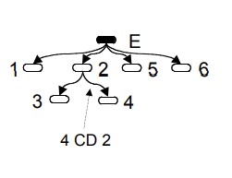
Data Dependence
Dependence Relations
L₁
Influence is more than control, it’s also what values mattered to your behavior
L₂
L₃
L₄
1: READ i;
2: if ( i == 1)
3: PRINT “hi!”
else
4: i = 1;
5: PRINT i;
6: end
L₅
L₆
Note here: a value at L₁ might have set a value at L₅, but it’s not control dependent!

Slide 17
The Data Dependence Graph
Dependence Relations
Depiction of the reaching definitions of each statement
Procedure
DDG
1: READ i;
2: if ( i == 1)
3: PRINT “hi!”
else
4: i = 1;
5: PRINT i;
6: end
L₁
L₄
L₃
L₂
L₅
L₆

Slide 18
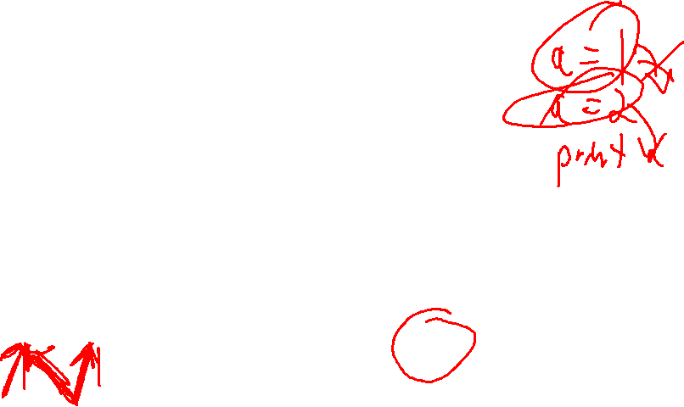
The Data Dependence Graph
Dependence Relations
CFG
{}
L₁
A def of i is found that reaches i@5 or i@2
Depiction of the reaching definitions of each statement
{i@5,i@2}
{i@5,i@2}
L₂
A use of i is found
Procedure
DDG
{i@5}
1: READ i;
2: if ( i == 1)
3: PRINT “hi!”
else
4: i = 1;
5: PRINT i;
6: end
{i@5}
L₁
L₄
L₃
{}
L₃
L₄
A def of i is found that reaches i@5
{i@5}
{i@5}
L₂
L₅
L₆
{i@5}
L₅
A use of i is found!
{}
{}
L₆
{}

Slide 19
Lecture Outline
Data Dependence
PDGs
Slicing

Slide 20
The Program Dependence Graph
Dependence Relations
An overlay of the CDG + DDG = PDG
CDG
PDG
1: READ i;
2: if ( i == 1)
3: PRINT “hi!”
else
4: i = 1;
5: PRINT i;
6: end
E
E
CFG
L₁
L₁
L₂
L₅
L₆
L₅
L₆
L₁
L₂
L₃
L₄
L₂
L₃
L₄
DDG
L₁
L₄
L₃
L₆
L₃
L₄
L₅
L₆
L₂
L₅

Slide 21
Lecture Outline
Data Dependence
PDGs
Slicing

Slide 22
The “SUB-Program” Concept
Program Slicing
Big Idea: ignore “Irrelevant” functionality for a particular case
Control Dependence Graph (CDG)
Shows what program statements depend on each other
Program Dependence Graph (PDG)
At minimum: A CDG enriched with data dependence information

Slide 23
The Slice of the Program
Program Slicing
Forward Slice
Backwards Slice
Everything influenced by statement K
Everything that influences statement K
Forward reachability in the PDG
Backward reachability in the PDG
Forward Slice
Program
x = rand()
y = rand()
x = net_read()
if (y == 1){
printf(“hello”);
}
if (x > 2){
x = 2;
}
array[x] = 4;
x = net_read()
if (x > 2){
x = 2;
}
array[x] = 4;
Backward Slice
y = rand()
if (y == 1){
printf(“hello”);
}

Slide 24
Slice Execution
Program Slicing
Do we need our sliced subprogram to BE Executable?
If so, we may need to include additional instructions

Slide 25
Output dependence
Program Slicing
Do we need our sliced subprogram to perform identically to the original?
If so, we’ll need additional output dependence edges

Slide 26

Slicing Summary
Program Slicing
Static Slicing has some promising applications
It’s not a one-size-fits-all scalability panacea
Any (sound) slicing is likely a benefit!
Some applications Beyond analysis
Automatic parallelization
Software metrics (how big of a change is this refactor?)

Slide 27

Analysis Tools
Switching Gears
We’ve Covered several popular analysis techniques for imperative programming
Let’s talk a bit about their tooling

Slide 28
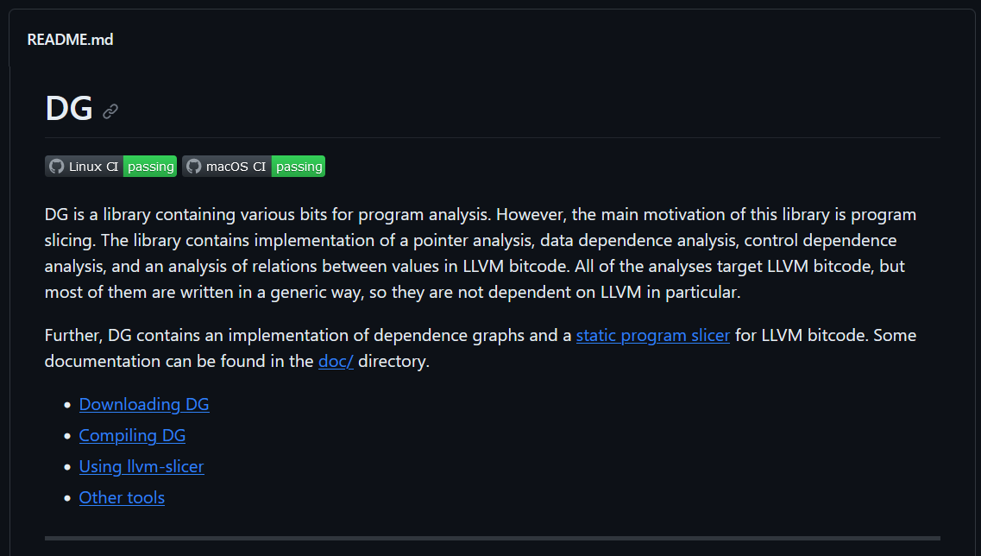
LLVM: Static Slicing
Analysis Tools
https://github.com/mchalupa/dg

Slide 29

Next Time
Dealing with “Real” programs
Pointers
(after that) Classes
(after that) Interprocedural Analysis

