Slide 1
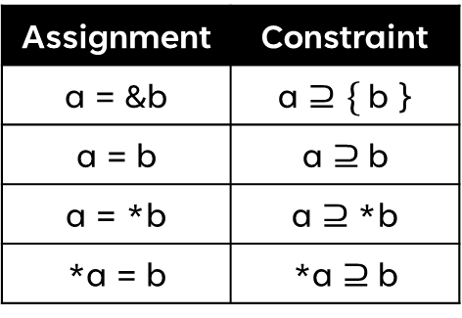
Exercise 23
Points-To Analysis Review
Write your name and answer the following on a piece of paper
Draw the points-to graph of the following snippet:
Assignment | Constraint
a = &b | a $⊇\{$b }
a = b | a $⊇$b
a = *b | a $⊇$*b
*a = b | *a $⊇$b

Slide 2
Exercise 23 Solution
Points-To Analysis Review
Assignment | Constraint
a = &b | a $⊇\{$b }
a = b | a $⊇$b
a = *b | a $⊇$*b
*a = b | *a $⊇$b

Slide 3
Exercise 23
Points-To Analysis Review
Write your name and answer the following on a piece of paper
Draw the points-to graph of the following snippet:
Assignment | Constraint
a = &b | a $⊇\{$b }
a = b | a $⊇$b
a = *b | a $⊇$*b
*a = b | *a $⊇$b

Slide 4
Exercise 23 Solution
Points-To Analysis Review
Assignment | Constraint
a = &b | a $⊇\{$b }
a = b | a $⊇$b
a = *b | a $⊇$*b
*a = b | *a $⊇$b

Slide 5
Administrivia and
Announcements
Quiz 2 on Monday
Review session: Friday at 6:30 PM, Location TBA

Slide 6
Program Instrumentation
EECS 677: Software Security Evaluation
Drew Davidson

Slide 7
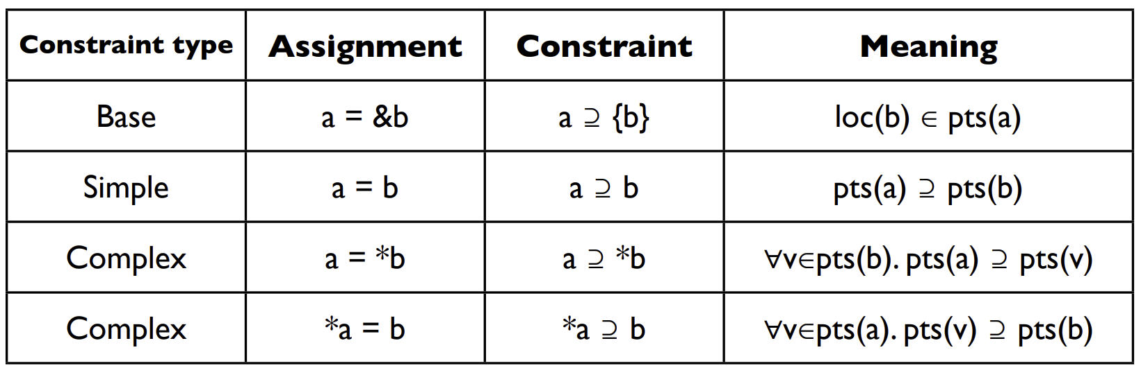
Andersen’s Algorithm
Review: Last Lecture
Reachability formulation
Step 1: Extract pointer-related operations
Step 2: Saturate points-to graph
Step 3: Compute node reachability

Slide 8
Andersen’s Algorithm: Reachability
Review: Last Lecture
Program
Constraints
a
Reachability formulation
p = &a
p = &b
m =&p;
r = *m;
q = &c;
m = &q
p ⊇ {a}
p ⊇ {b}
m ⊇ {p}
r ⊇ *m
q ⊇ {c}
m ⊇ {q}
Step 1: List pointer-related operations
Step 2: Saturate points-to graph
Step 3: Compute node reachability
p
r
m
b
Initial
Final
c
q
pts(a) = { }
pts(b) = { }
pts(m) = { }
pts(p) = { }
pts(q) = { } pts(r) = { }
pts(a) = { }
pts(b) = { }
pts(m) = { p, q }
pts(p) = { a, b }
pts(q) = { c }
pts(r) = { a, b, c }

Slide 9

Points To and Type Saftey
Review: Last Lecture
A “Feature” of the Analysis
Our points-to relationships are somewhat contrived
Would a program ever actually
have both of these statements?
*a = b;
*a = *b;

Slide 10
Program Instrumentation
EECS 677: Software Security Evaluation
Drew Davidson

Slide 11
Lecture Outline
Steensgard’s Analysis
Static Analysis Underview
Program Instrumentation

Slide 12

Overhead
Andersen’s Analysis
Worst Case: Cubic Time
That’s not great!
Most of the time is spent in re-analyzing constraints to get to a fixpoint
prof
e
points-to analysis
Optimization:
Cycle elimination
scale
Detect and collapse SCCs in the points-to relation

Slide 13

A more-efficient Points-To
STeensGard’s Analysis
Return again to our ancient wisdom
Simpler abstractions reach fixpoints faster

Slide 14

A more-efficient Points-To
STeensGard’s Analysis
Return again to our ancient wisdom
Simpler abstractions reach fixpoints faster
You can only point to 1 node
Steengard’s Analysis
If you need to point to > 1 node, merge the “pointees”
Limit the points-to graph nodes to have outdegree <= 1
Simplifies many points-to constraints from subsets to equalities
Achieves near-linear performance

Slide 15
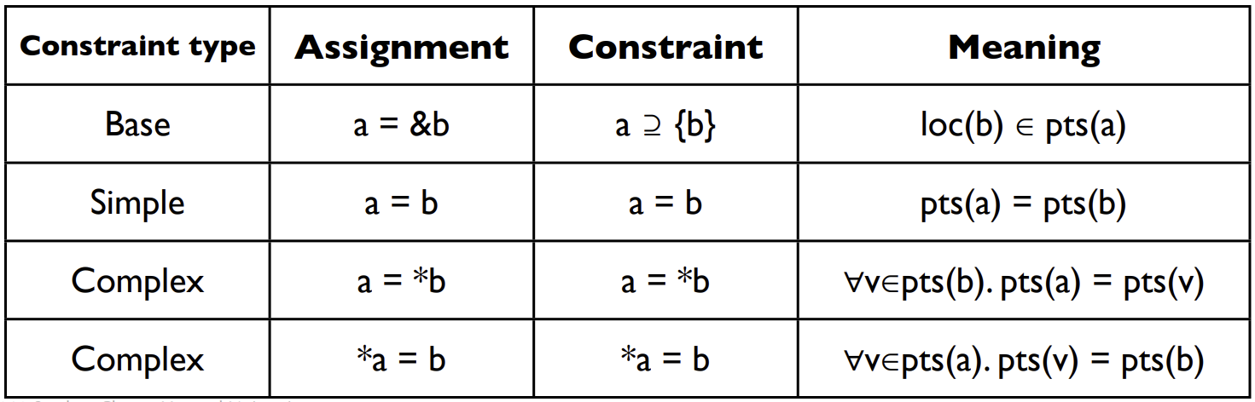

SteenGard’s Algorithm
An efficient over-approximation
Andersen’s
In Practice
Step 1
List pointer-related operations
Step 2
Induce set of subset constraints
Step 3
Solve system of constraints
equality
Reachability formulation
Step 1
List pointer-related operations
Step 2
Saturate points-to graph
Step 3
Compute node reachability
Steengaard’s
1-out

Slide 16
Equality Constraints
Steensgard’s Analysis

Slide 17

Equality Constraints
Steensgard’s Analysis
p = &a
p
a
p = &b
p
a,b
m = &p
m
p
a,b
r = *m
m
p
a,b
r
q = &c
m
p
a,b
r
q
c
m = &q
m
p,q
a,b,c
r

Slide 18
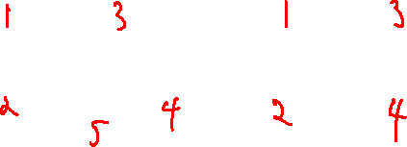
Equality Constraints
Steensgard’s Analysis
Andersen’s
Steensgard’s
p = &x
r = &p
q = &y
s = &q
r = s
x
y
x
y
x
y
xy
p
q
p
q
pq
pq
r
s
r
s
r
s
r
s

Slide 19
That’s Points-To!
Steensgard’s Analysis
An additional overlay on dataflow
Dataflow facts also flow to aliases
When dereferencing a pointer, consider only pointed-to objects

Slide 20
Lecture Outline
Steensgard’s Analysis
Static Analysis Underview
Program Instrumentation

Slide 21

Static Analysis Ready to go!
Static Analysis Underview
Dataflow analysis can be adopted for checking a variety of security / correctness properties
Forms the basis of a lot of static analysis!
Applicable for a variety of analysis goals
- Security leak detection
- Vulnerable program state detection
- Program understanding

Slide 22

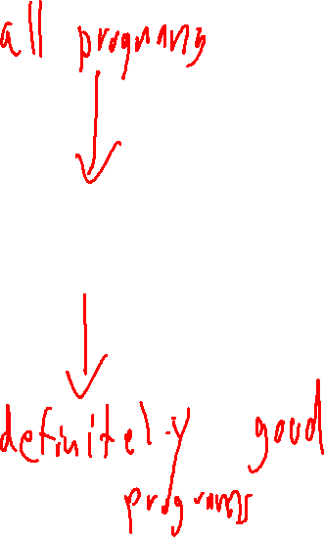
Static Analysis: Benefits
Static Analysis Underview
“The Analyst’s Sieve”
Focus your attention on potential issues
Non-interactive!
Can run in the background
Abstraction obviates need for input

Slide 23

Limits of Static Analysis
Program Instrumentation: Basic Idea
Practical Issues
Unsoundness of bug finding / incompleteness of program verification
Scalability
Significant engineering effort
Findings may not be super actionable

Slide 24
Lecture Outline
Steensgard’s Analysis
Static Analysis Underview
Program Instrumentation

Slide 25

Revising Dynamic Analysis
Program Instrumentation: Basic Idea
Giving up on Complete bug-finding
- Finding bugs (even “low-hanging fruit”) is useful!
Benefits
Scalability
Sound bug finding

Slide 26

Beyond Testing
Program Instrumentation: Basic Idea
Limitations of “Plain” Testing
- Property may not be immediately observable from output alone
- The circumstances under which the issue occurs may not be obvious

Slide 27
Program Instrumentation
Program Instrumentation: Basic Idea
Write code into the executable to gather information
Addresses both of the previous issues – can report upon program state and even program path

Slide 28
Example: LLVM Instrumentation
Program Instrumentation: Basic Idea
Write code into the executable to gather information
Addresses both of the previous issues – can report upon program state and even program path

Slide 29
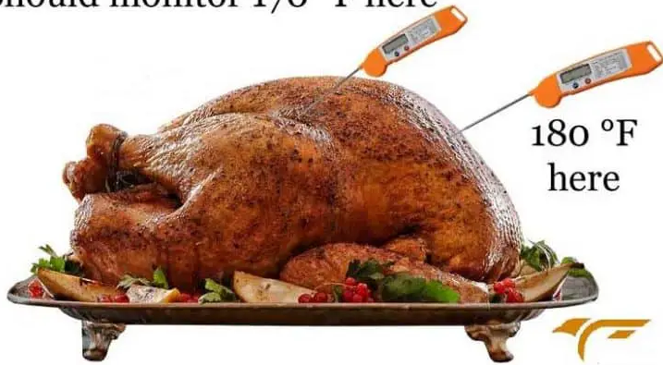
Inserting program Probes
Program Instrumentation: Basic Idea
Insert checks / Reports into the analysis target
Addresses both of the previous issues – can report upon program state and even program path
Many Programming languages have exploitable constructs
Programming constructs that do not operate as intended under unforeseen circumstances
A new concern – The efficiency of the (Instrumented) program
Potential slowdown on each program path
Old Concern – The efficiency of
Placement analysis
Somewhat limited by the information the probes can report

Slide 30

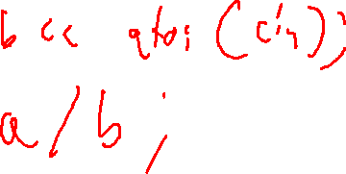
Example: CoDe CoveraGe
Program Instrumentation: Basic Idea

Slide 31
Example: CoDe CoveraGe
Program Instrumentation: Basic Idea
Counting How many times certain behaviors of the program are exercised
Why is this useful?
(Placing sanitizers)
This actually turns out to be a little bit tricky!
Actually turns out to be a little bit tricky!
We’ll describe some of the issues / solution as per Ball and Larus, ‘96

Slide 32
Wrap-up
We’ve begun to consider a way to move beyond static analysis while using our existing tools: Program instrumentation

