Slide 1
Exercise 5
LLVM MEMORY Review
Write your name and answer the following on a piece of paper
Write an LLVM IR function that simulates the following
int a;
int main(int argc){ return a + argc;
}

Slide 2
Administrivia and Announcements

Slide 3
LLVM calls
EECS 677: Software Security Evaluation
Drew Davidson

Slide 4

Class Progress
We’re Basically ready to do static Analysis

Slide 5
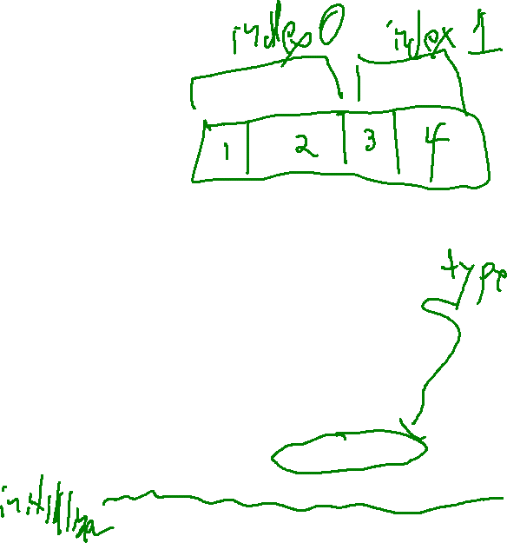
Last Time: LLVM MEMORY
Review: Last Lecture
Described LLVM’s Concept of Named Memory
No mathematical relationship between distinct named memory items
Guaranteed mathematical relation WITHIN named memory items (as exploited by GEP)
Declaring memory
Local memory:
%ptrL = alloca i32, align 4
Global memory:
@ptrG = global i32 2, align 4
(Global) constant: Guaranteed mathematical relation
@ptrC = constant i32 2, align 4
%ptrLarr = alloca [8 x i32], align 4
%ptrGstruct = global i32 {i32, i8}, align 4
@ptrCstructs = constant [2 x {i8, i32}]
[{i8, i32} {i8 1, i32 2}, {i8, i32}{ i8 3, i32 4} ] ,
align 4

Slide 6
Last Time: LLVM MEMORY
Review: Last Lecture
Declaring memory
Local memory:
%ptrL = alloca i32, align 4
Global memory:
@ptrG = global i32 2, align 4
(Global) constant: Guaranteed mathematical relation
@ptrC = constant i32 2, align 4
%ptrLarr = alloca [8 x i32], align 4
%ptrGstruct = global i32 {i32, i8}, align 4
@ptrCstructs = constant [2 x {i8, i32}]
[{i8, i32} {i8 1, i32 2}, {i8, i32}{ i8 3, i32 4} ] ,
align 4
Accessing memory
Store scalar:
store i32 1, i32* %ptrL
Global memory:
%reg = load i32, i32* @ptrG

Slide 7
Lecture Outline
GEP
Function calls

Slide 8

GetElementPtr
The Dreaded GEP
Here is the Basic format of a GEP
<result> = getelementptr <ty>, ptr <ptrval>{, [inrange] <ty> <idx>}*
Here is a snippet of the documentation of the syntax:
The first argument is always a type used as the basis for the calculations. The second argument is always a pointer or a vector of pointers, and is the base address to start from. The remaining arguments are indices that indicate which of the elements of the aggregate object are indexed. The interpretation of each index is dependent on the type being indexed into. The first index always indexes the pointer value given as the second argument, the second index indexes a value of the type pointed to (not necessarily the value directly pointed to, since the first index can be non-zero), etc. The first type indexed into must be a pointer value, subsequent types can be arrays, vectors, and structs. Note that subsequent types being indexed into can never be pointers, since that would require loading the pointer before continuing calculation.

Slide 9
GetElementPtr
The Dreaded GEP
Let me (maybe?) Simplify this a bit with a slight reformat of GEP
base
array index
Field traversal
<result> = getelementptr <ty_{work}>, <ty_{src}> <src>, <idxtype> <siblingidx>, [<idxtype> <fieldidx>]+
Here is my explanation of this version of GEP:
Assume base is a pointer into some array of somethings (possibly a nested data structure)
- Arg 1: <ty_{work}>: Specify the type of the somethings
- Arg 2: <ty_{src}> <src>: base address to start your computation
- Arg 3: <idxtype> <siblingidx>: array index to jump forward from the base address
(end of optional arguments)
- Arg 4+: <idxtype> <fieldidx>: field traversal to index into the fields of the nested data structure

Slide 10

GetElementPtr
The Dreaded GEP
Let me (maybe?) Simplify this a bit with a slight reformat of GEP
base
array index
Field traversal
<result> = getelementptr <ty_{work}>, <ty_{src}> <src>, <idxtype> <siblingidx>, [<idxtype> <fieldidx>]+
Answer:
Very generic format to capture the large variety of ways that you need to index into memory
Basic GEP invocations handle simple cases
Complex GEP invocations handle complex cases

Slide 11
GetElementPtr
The Dreaded GEP
Let me (maybe?) Simplify this a bit with a slight reformat of GEP
base
array index
Field traversal
<result> = getelementptr <ty_{work}>, <ty_{src}> <src>, <idxtype> <siblingidx>, [<idxtype> <fieldidx>]+
Answer:
7
7
7
Very generic format to capture the large variety of ways that you need to index into memory
Basic GEP invocations handle simple cases
getelementptr %T2, ptr @ptr_n1, i64 0, i64 0
Complex GEP invocations handle complex cases

Slide 12
GetElementPtr: Pictorially
The Dreaded GEP
Can be helpful to walk through memory as a tree
%T1 = type { i32, i32, i32 }
ptr_n1
%T2 = type [ 2 x %T1 ]
@ptr_n1 = global %T2 [ { i32 1, i32 2, i32 3 }, { i32 4, i32 5, i32 6} ]
n1
“base addr”
“sibling 0”
“field 0”
ptr_n2 =
getelementptr %T2, ptr @ptr_n1, i64 0, i64 0
n2
n3
ptr_n2
a₀
b₀
c₀
a₁
b₁
c₁

Slide 13
GetElementPtr: Pictorially
The Dreaded GEP
Can be helpful to walk through memory as a tree
%T1 = type { i32, i32, i32 }
ptr_n1
%T2 = type [ 2 x %T1 ]
@ptr_n1 = global %T2 [ { i32 1, i32 2, i32 3 }, { i32 4, i32 5, i32 6} ]
n1
ptr_n2 =
getelementptr %T2, ptr @ptr_n1, i64 0, i64 0
“base addr”
“sibling 1”
“field 1”
ptr_b1 =
getelementptr %T1, ptr @ptr_n2, i64 1, i64 1
n2
n3
ptr_n2
a₀
b₀
c₀
a₁
b₁
c₁
ptr_b1

Slide 14
GetElementPtr: Pictorially
The Dreaded GEP
Can be helpful to walk through memory as a tree
%T1 = type { i32, i32, i32 }
ptr_n1
%T2 = type [ 2 x %T1 ]
@ptr_n1 = global %T2 [ { i32 1, i32 2, i32 3 }, { i32 4, i32 5, i32 6} ]
n1
ptr_n2 =
getelementptr %T2, ptr @ptr_n1, i64 0, i64 0
“base addr”
“sibling 1”
“field 1”
ptr_b1 =
getelementptr %T1, ptr @ptr_n2, i64 1, i64 1
n2
n3
ptr_n2
a₀
b₀
c₀
a₁
b₁
c₁
ptr_b1

Slide 15
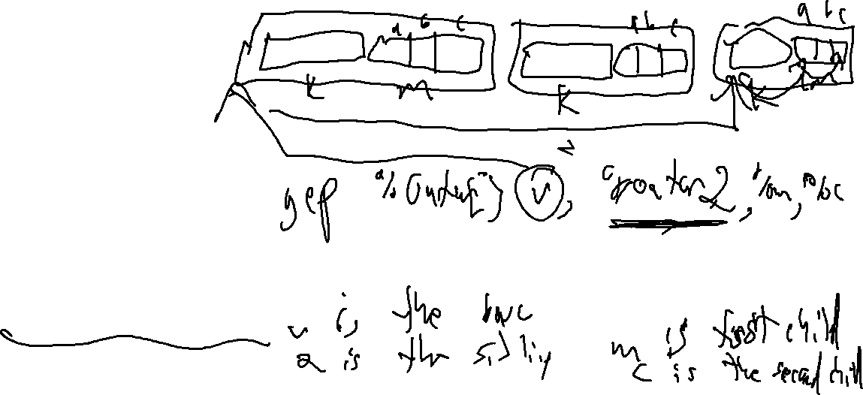
GetElementPtr: Ya Gotta Handle C
The Dreaded GEP
My Theory: GEP is designed to accommodate the needs of C source code
struct Inner {
int32_t a;
int8_t b;
char c;
};
struct Outer{
int32_t k;
struct Inner m;
}
struct Outer v[3];
int main(){ v[2].m.c = ‘X’;
}

Slide 16
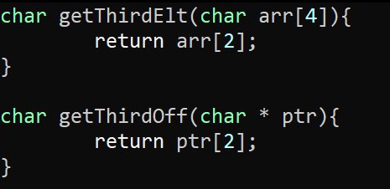
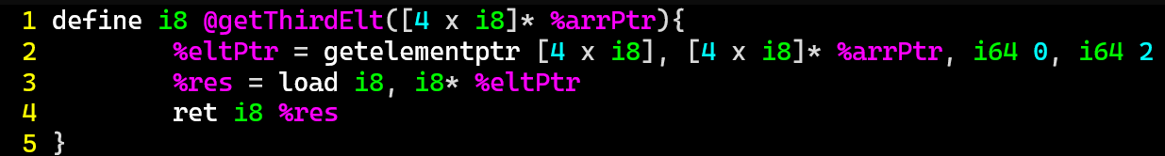
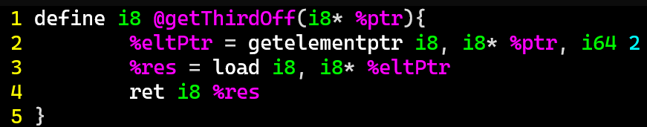
GEP For Source Code
LLVM Bitcode

Slide 17

Writing “Interesting” Programs
LLVM Bitcode
We can now write Turing complete programs
But these programs are very Boring!
We need to interact with external functionality

Slide 18
LLVM Calls
LLVM Bitcode
General syntax
call <callee sig> <function name> ( <argList> )
%res = call i32(i32,i32) @max (i32 1, i32 2)
Somewhat surprisingly, does not (always) require the full function signature of the callee!
Constrained Syntax
call <return type> <function name> ( <argList> )
%res = call i32 @max (i32 1, i32 2)
The general syntax IS required if a function has varargs
%len = call i32 (i8*, ...) @printf(i8* %strPtr, i32 123)

Slide 19

LLVM External Calls
LLVM Bitcode
Example
%len = call i32 (i8*) @atoi(i8* %elt1)
“libc”
A hero arrives
declare i32 @atoi(i8*)

Slide 20
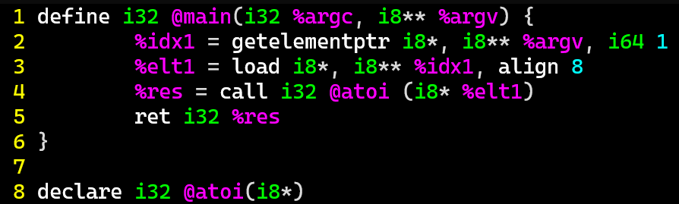

LLVM AtoI
LLVM Bitcode
Let’s invoke a Somewhat-familiar function…

Slide 21
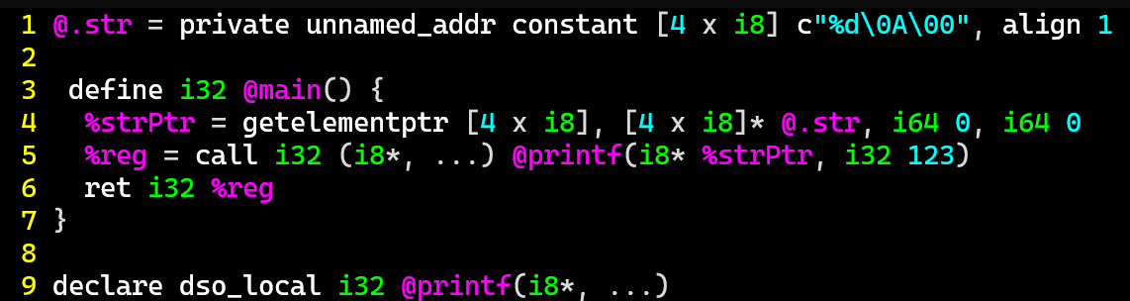

LLVM PRINTF
LLVM Bitcode
Getting more convenient output from our programs

Slide 22
RUNNING THE LLVM TOOLS: CLANG
LLVM Bitcode
clang -S -emit-llvm foo.c -o foo.ll -disable-O0-optnone

Slide 23
Wrap-up

Slide 24
Next Time
WRITING AN ANALYSIS

