Slide 1
Exercise 16
Program Slicing Review
Write your name and answer the following on a piece of paper
Draw the forward slice from line 2 in following program:
1: int main(int argc, const char * argv[]){
2: const char * a = argv[1];
3: int b = argc;
4: if (a[0] == 'a'){
5: if (b > 2){
6: return 2;
7: }
8: } else {
9: b = 4;
10: }
11: b = 7;
12: return 3;
13: }

Slide 2
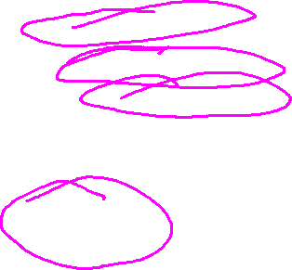
Exercise 16 Solution
Program Slicing Review

Slide 3
Administrivia and
Announcements

Slide 4
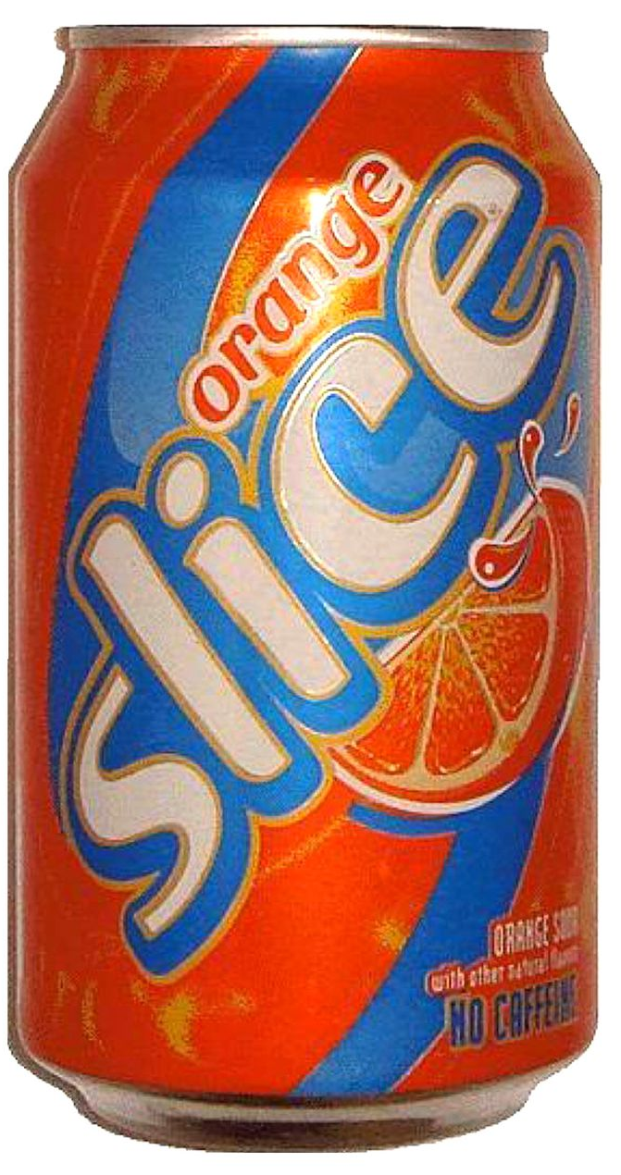
Last Time: The Program Slice
Review: Program Slicing
Extract a sub-program of interest based on one (or more) statements
Forward slice
Capture all code influenced by a given statement
Backwards slide
Capture all code influencing a given statement
program

Slide 5

Constructing the Slice
Review: Program Slicing
Extract the Control-Flow Graph (CFG)
Construct Basic Blocks, make control transfers edges
Extract the Postdominator Tree from the CFG
(done via a dataflow analysis)
Capture the IFDOM relationship
Backwards edges in the postdominator tree
Build the Control-Dependence Graph (CDG)
Backwards edges in the postdominator tree
Build the Data-Dependence Graph (DDG)
Backwards edges in the reaching definitions
Build the Control-Dependence Graph (PDG)
Add all edges from the DDG to the CDG
Construct the transitive closure of PDG edges
Forward: against dependence, Backwards: with dependence
slice a
program

Slide 6

Uses for Program Slices
Review: Program Slicing
Program Comprehension
What is this statement doing?
Debugging
(done via a dataflow analysis)
Scaling heavyweight analysis
Less program to test

Slide 7
VIBE CHeck
Dataflow analysis is super useful!
We’ve achieved a milestone in our analysis
We did leave out a handful of program features…
Functions
Global Variables
Classes / Dynamic Dispatch
Pointers / References

Slide 8
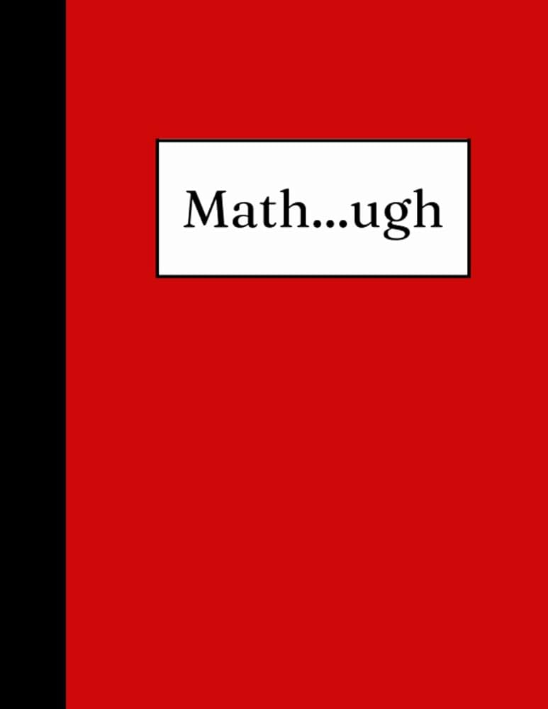
Is this stuff Useful?
Vibe Check
Empirically, Yes
Windows PREfast and Static Driver Verifier
Even shipped with some versions of Visual Studio
PREfast for Drivers: only analyzes a single function
Official bug numbers are hard to come by, but anecdotally they have been crucial in reducing Windows DOS
Coverity
Static analysis tool originally from Stanford

Slide 9
Is this stuff Useful?
Vibe Check
Empirically, Yes
Windows PREfast and Static Driver Verifier
Even shipped with some versions of Visual Studio
PREfast for Drivers: only analyzes a single function
Under a United States Department of Homeland Security contract in 2006, the tool was used to examine over 150 open source applications for bugs; 6000 bugs found by the scan were fixed across 53 projects.^{[4]}
National Highway Traffic Safety Administration used the tool in its 2010-2011 investigation into reports of sudden unintended acceleration in Toyota vehicles.^{[5][6]} The tool was used by CERN on the software employed in the Large Hadron Collider^{[7][8]} and in the NASA Jet Propulsion Laboratory during the flight software development of the Mars rover Curiosity.^{[9]}
- Wikipedia
Official bug numbers are hard to come by, but anecdotally they have been crucial in reducing Windows DOS
Coverity
Static analysis tool originally from Stanford

Slide 10
Interprocedural Analysis
EECS 677: Software Security Evaluation
Drew Davidson

Slide 11

Scaling up our analysis
Interprocedural Analysis
Intraprocedural analysis is useful!
PREfast Driver shows the importance in special cases
Interprocedural analysis is useful!
Coverity shows the importance in more general cases

Slide 12
Lecture Outline
Abject Pessimism
ICFGs
Context-Sensitivity
Summary Functions

Slide 13
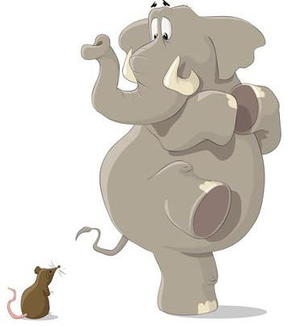
worst-Case Assumptions
Naïve Approach
Create Simple, “Safe” Over-Approximation
What constitutes “being safe” depends on your analysis
Example 1, confidentiality: Assume a function call tags all reachable data as confidential
Example 2, integrity: Assume a function call tags all reachable data as untrusted
Function
call
Static
analysis

Slide 14
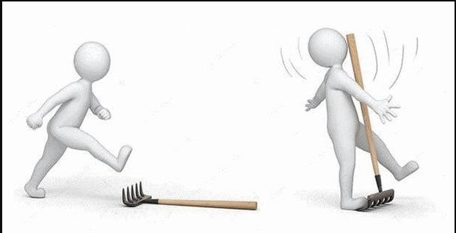
Worst-Case Assumptions
Naïve Approach
Our general philosophy: “Do no harm” guarantees
Recall our notions of soundness and completeness:
- Sound: no false positives (“tells no lie”)
- Complete: no false negatives (“omits no truth”)
“Being safe” Requires formulating analysis goal
bug hunting:
- Report buggy programs
- Safe means complete analysis
program verification:
- Report clean programs
- Safe means sound analysis
Anything that can go wrong will go wrong
- Murphy’s Law

Slide 15
Tightening the Bounds
Naïve Approach
Attempt to get tighter and tighter bounds retaining completeness
Approximation 1
Address areas of imprecision that are only adding false positives.
Approximation 2
Approximation 3
Truth

Slide 16
Lecture Outline
Abject Pessimism
ICFGs
Context-Sensitivity
Summary Functions

Slide 17

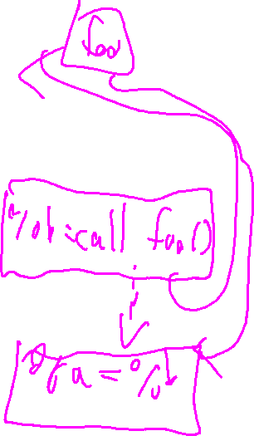
The Obvious Interprocedural Solution
Interprocedural Analysis: ICFGs
Just add edges from a call site to the callee
Builds the interprocedural control flow graph (ICFG) aka “supergraph”

Slide 18

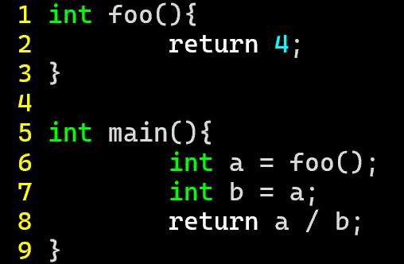
The Obvious Interprocedural Solution
Interprocedural Analysis: ICFGs
Just add edges from a call site to the callee
Builds the interprocedural control flow graph (ICFG) aka “supergraph”
int main(){
int a = foo();
int foo(){
return 4;
int b = a;
return a / b

Slide 19
Cost/Benefit of supergraphs
Interprocedural Analysis: ICFGs
Benefits of ICFGs
Better than abject pessimism!
Minimal modification to intraprocedural algorithms
Costs of ICFGs
May not be obvious what the callee is
Naïvely leads to some erroneous paths

Slide 20
Cost/Benefit of supergraphs
Interprocedural Analysis: ICFGs
Costs of ICFGS
May not be obvious what the callee is
We can separate that concern into a call graph analysis

Slide 21
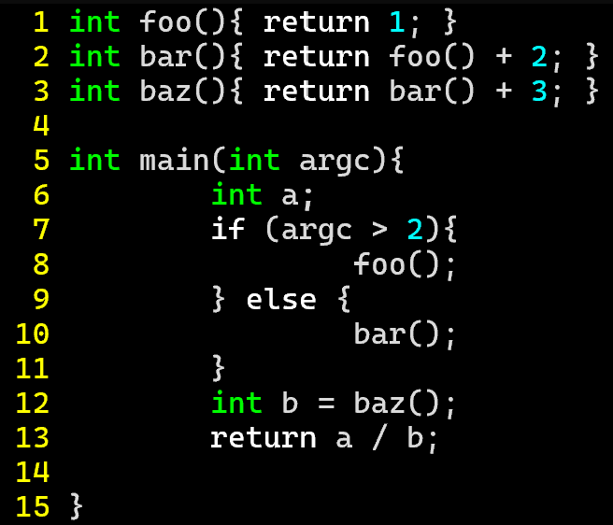
Call Graphs
Interprocedural Analysis: ICFGs
Costs of ICFGs
Simple call graph:
connect caller functions to callee functions
- Node: function
- Edge: function call
May not be obvious what the callee is
We can separate that concern into a call graph analysis
foo
main
bar
baz

Slide 22
Call Graphs
Interprocedural Analysis: ICFGs
Better
Costs of ICFGs
Call sites
Simple call graph:
connect caller functions to callee functions
- Node: function
- Edge: function call
May not be obvious what the callee is
We can separate that concern into a call graph analysis
with nested call sites
foo
main
bar
8
2
10
12
baz
3

Slide 23
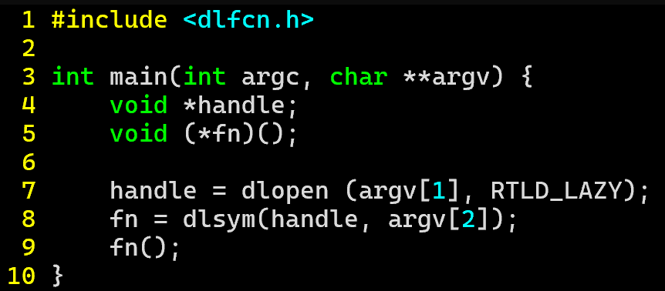
Call Graphs
Interprocedural Analysis: ICFGs
Costs of ICFGs
May not be obvious what the callee is
We can separate that concern into a call graph analysis
In the case of imprecision, over-approximate behaviors

Slide 24
The Other Thing About SuperGraphs
Interprocedural Analysis: ICFGs
Costs of ICFGs
May not be obvious what the callee is
We can separate that concern into a call graph analysis
In the case of imprecision, over-approximate behaviors

Slide 25
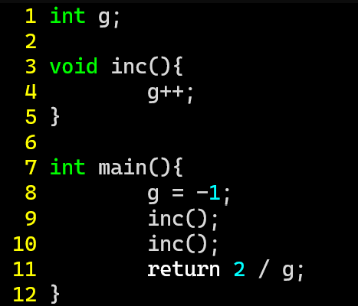
The Other Thing About SuperGraphs
Interprocedural Analysis: ICFGs
Costs of ICFGs
May not be obvious what the callee is
We can separate that concern into a call graph analysis
In the case of imprecision, over-approximate behaviors
int main(){
g = -1;
inc();
Naïvely leads to some impossible paths
void inc(){
g++;
inc();
return 2 / g;

Slide 26
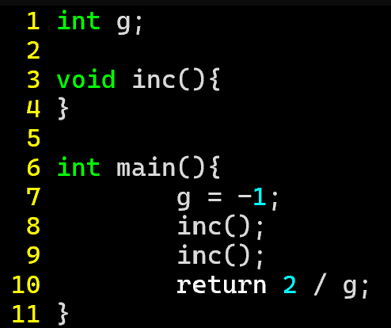

The Other Thing About SuperGraphs
Interprocedural Analysis: ICFGs
Costs of ICFGs
May not be obvious what the callee is
We can separate that concern into a call graph analysis
In the case of imprecision, over-approximate behaviors
int main(){
g = -1;
inc();
Naïvely leads to some impossible paths
void inc(){
g++;
inc();
return 2 / g;

Slide 27
Lecture Outline
Abject Pessimism
ICFGs
Context-Sensitivity
Summary Functions

Slide 28
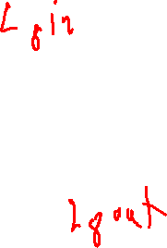
(Calling) Context Sensitivity
Interprocedural Analysis: ICFGs
The problem in the simple supergraph analysis
A lock of calling context
(return to the wrong call site)
This provides another way to “tune” a flow analysis
Flow-sensitive vs Flow-insensitive
Context-sensitive vs Context-insensitive
tracks some
amount of
context
int main(){
g = -1;
inc();
void inc(){
g++;
inc();
return 2 / g;

Slide 29
Call Strings and K-CFA
Interprocedural Analysis: ICFGs
How much context to Keep?
Obvious problem: can’t distinguish between callers
(context-insensitive analysis)
Obvious solution: Call strings
Keep track of the caller
1-CFA
Obvious problem: what about the caller’s caller?
Obvious solution: keep track of the caller’s caller?
2-CFA
“k-CFA popularized the idea of context-sensitive flow analysis. […] in the OO setting, where a 1- and 2-CFA analysis is considered heavy but certainly possible”
- Might et al, Resolving and Exploiting the k-CFA Paradox

Slide 30
Another Form of Context Sensitivity
Interprocedural Analysis: Context-Sensitivity
A (perhaps) More conceptually Straightforward Approach…
Rather than complicating the edges, what if we cloned the nodes
int main(){
g = -1;
inc();
void inc(){
g++;
void inc(){
g++;
inc();
return 2 / g;

Slide 31
Another Form of Context Sensitivity
Interprocedural Analysis: Context-Sensitivity
A (perhaps) More conceptually Straightforward Approach…
Rather than complicating the edges, what if we cloned the nodes
“Exploded supergraph”: 1 clone per static call site
Still very much not foolproof
int main(){
g = -1;
inc();
void inc(){
g++;
void inc(){
g++;
inc();
return 2 / g;

Slide 32
Lecture Outline
Abject Pessimism
ICFGs
Context-Sensitivity
Summary Functions

Slide 33
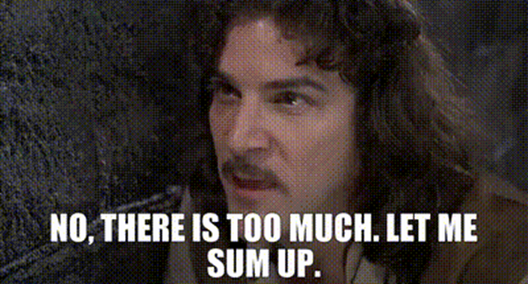
summary Functions
Supergraphs
Big Idea
Summarize callee analysis (rather than include it in the analysis)
Manual Manifestation
Ask the user to provide information
Automatic Manifestation
Create a lightweight inference
- What variables are (transitively) modified as a result of a function call? GMOD
- What variables are (transitively) referenced as a result of a function call? GREF

Slide 34
Wrap-up

