Slide 1
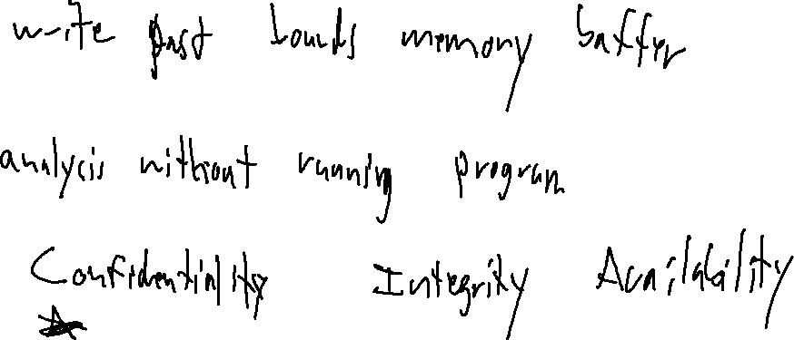
Exercise #1
Baseline KnowlEdge Review
Write your name and answer the following on a piece of paper
(I have paper for this class only)
What is a buffer overflow attack? What are the consequences of such an attack?
What is static analysis?
In computer security, to what does the CIA triad refer?

Slide 2
Overview
EECS 677: Software Security Evaluation
Drew Davidson

Slide 3

Fast Facts from the Jump
I’m recording this Lecture
I’ll post the video And these slides on the class Website

Slide 4
Administrivia and Announcements
ASSIGNMENTS
Entry Survey
Out now
Due tonight at 11:59 PM on Canvas
Exercise #1
If you’re here, you just got 100%
If you missed this class, due on Sunday at 11:59 PM
In the future, you’ll need to bring your own pencil + paper

Slide 5
Today’s Roadmap
Orientation
About me
About you
About the course
Evaluating Evaluation

Slide 6
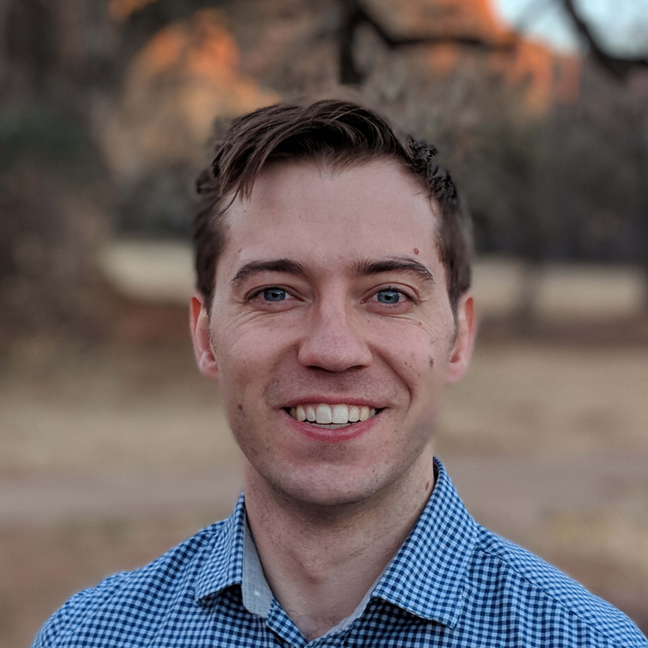
About ME
…and an
administrator
A scientist
…and also a
teacher
( Associate ) Professor
Andrew “Drew” Davidson
Pronouns: he/him/his

Slide 7
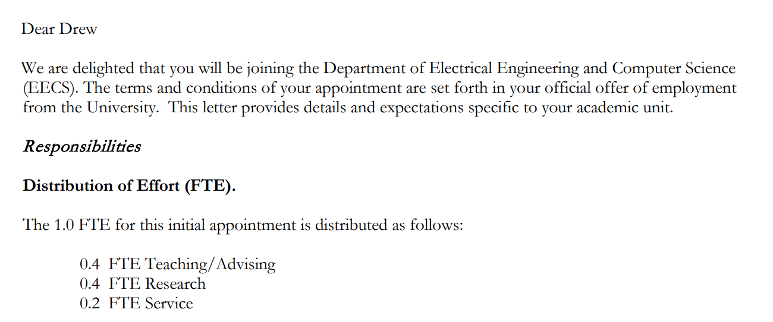
The Job of a Professor
About Me
The actual start of my job offer letter from KU:

Slide 8
I’m A Mandatory Reporter
About Me
https://civilrights.ku.edu/sexual-misconduct
I (like nearly all KU faculty and staff) am designated as a mandatory reporters.
I’m required to report incidents of discrimination and sexual harassment, including sexual violence, to the Office of Civil Rights & Title IX.
The following positions are not mandatory reporters and can keep your information confidential:
CARE (Campus Assistance, Resource, and Education) Coordinator 785-864-9255 | care@ku.edu
KU Counseling and Psychological Services (CAPS) 785-864-2277 | caps.ku.edu
University Ombuds 785-864-7261 | ombuds@ku.edu

Slide 9
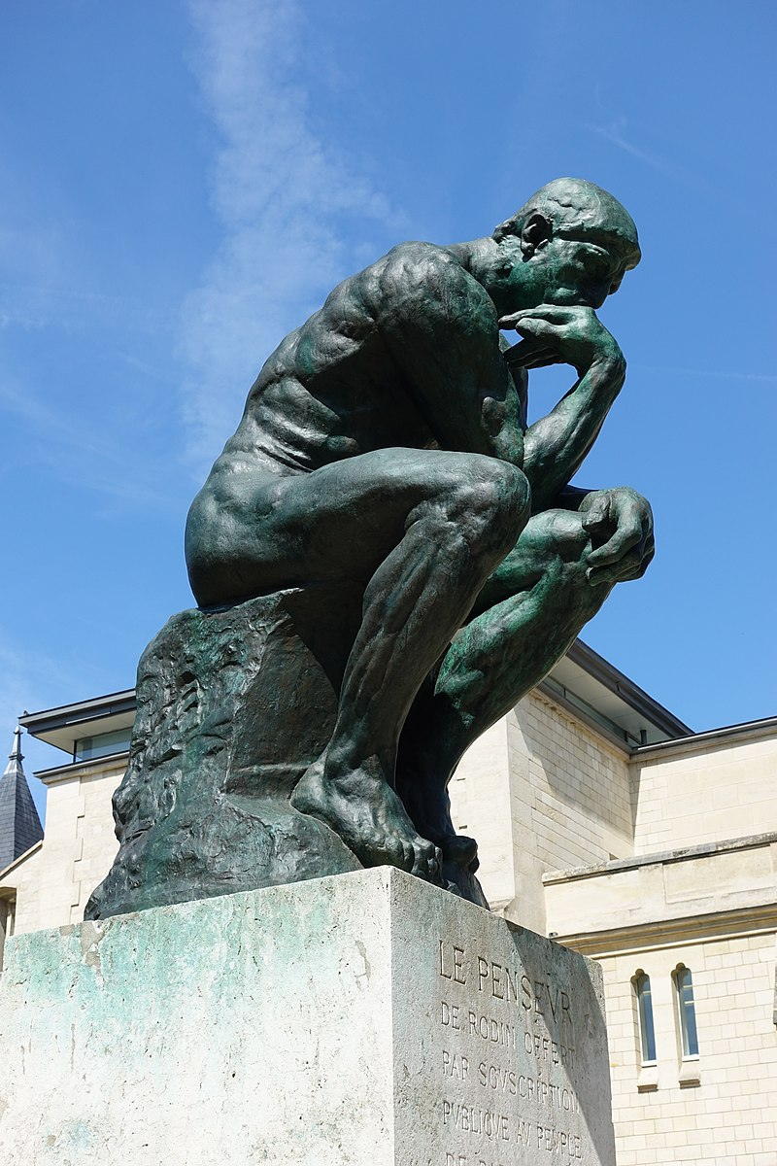
MY Teaching Philosophy
About Me
How
Teach?
Teach the class I’d like to take
Treat your time as a valuable resource
Avoid the annoyances I experienced as a student
Objectives – Teach a class that is
Entertaining
Enjoyable
Informative
Most important
“Like what?”

Slide 10

What to call Me
About Me
Preferred: “Drew”
Ok: “Professor Davidson”, “Dr. Davidson”
Never: “Andy”, “Andrew”, “Mr. Davidson”, “Dr. Drew”
Dr. Drew (Extremely not me) [1]
[1]: Credit: www.podcastone.com/Dr-Drew-Show

Slide 11

Interacting With Me
About Me
(I think)
I am pretty friendly
I’ll make an effort to learn every student’s name
If you see me outside of class, feel free to say “hi!”
I like when you visit office hours
Appreciate when you come with a specific question

Slide 12
Today’s Roadmap
Orientation
About me
About you
About the course
Evaluating Evaluation

Slide 13
Class Composition
84% Undergraduate Student
16% Graduate STUDENT

Slide 14
Course Entry Survey
About You
To get a better sense of each student, I’m also asking you to complete a brief (private) survey
https://analysis.cool/survey

Slide 15
Your Hypothetically Asked Questions (HAQ)?
About You
Is Drew a Good Teacher?
Maybe?

Slide 16
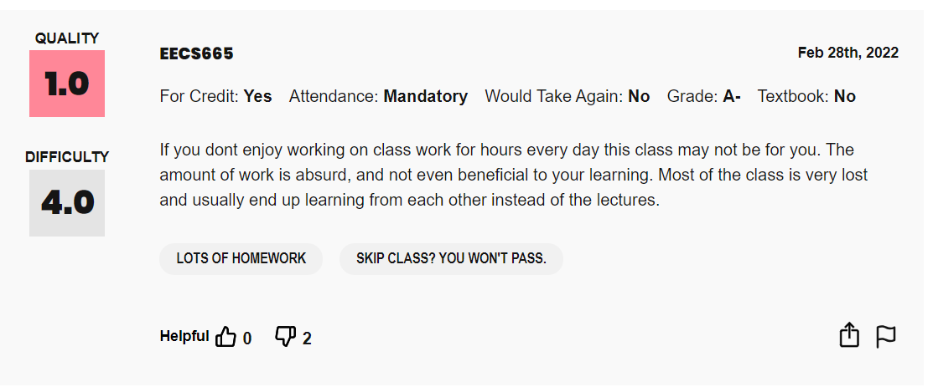
Your Hypothetically Asked Questions (HAQ)?
About You
Is Drew a Good Teacher?
Maybe?

Slide 17
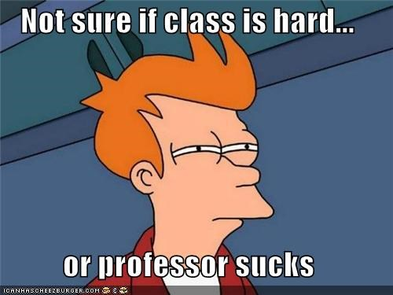
Your Hypothetically Asked Questions (HAQ)?
About You
Is Drew a Good Teacher?
Is This Class Hard?
Maybe?
Depends what you mean!

Slide 18
IS This Class Hard?
About You: HAQ
Depends on your definition of “hard”
“A Lot of work”
I hope it’s a moderate amount of work
“Success is rare”
Probably not
Grade Breakdown
Survey - 1%
Quizzes – 39% (planning on 3 total)
Exercises – 10%
Homework – 50%
“Miserable”
I want this to be “No”
“Conceptually Complex”
I want this to be “yes”

Slide 19
Your Hypothetically Asked Questions (HAQ)?
About You
Is Drew a Good Teacher?
Is This Class Hard?
Do I have to Come to Class?
Maybe?
Depends what you mean!
No!

Slide 20
Expectations of You
About You
Attendance
My assumption is that you will engage with this class
Your attendance is rewarded, but not required
Exercises Decision Flowchart
Did you turn in the exercise in class?
yes
no
Is it correct?
Turn it in on Canvas
no
yes
Is it correct?
yes
no
Full credit
Partial credit

Slide 21
Expectations of You
About You
Administrivia
Class website: https://analysis.cool
You’re expected to read the website
Piazza (link in syllabus and on website)
You’re expected to read Piazza
Canvas
You’re expected to turn in assignments
through canvas

Slide 22
Expectations of You
About You
Depends somewhat on the course you’re in
EECS 677 vs EECS 777

Slide 23
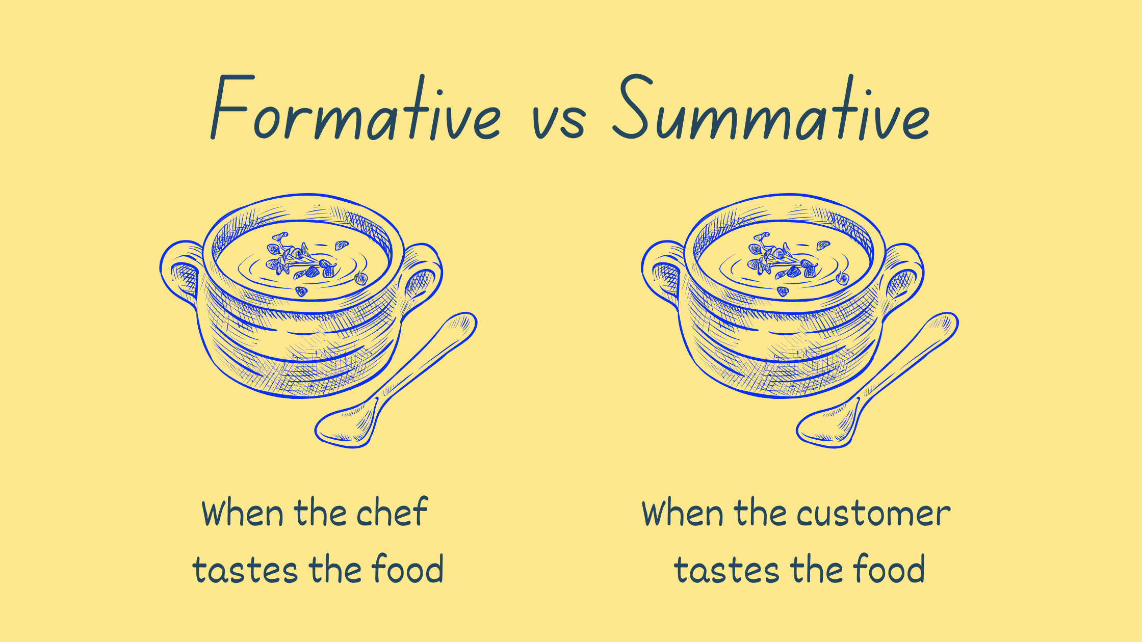
Expectations of You
About You
Formative vs Summative Assessment
Sometimes I ask you to do something to show you how to do it
Sometimes I ask you to do something to prove you can do it

Slide 24
Today’s Roadmap
Orientation
About me
About you
About the course
Evaluating Evaluation

Slide 25

This Course is Built For You!
About You
My effort is only as valuable as the result
- If you’re having trouble, let me know!
I value feedback
This course improves by matching your needs
I encourage questions, comments, etc. (within reason)

Slide 26
Course TOPIC
Tools and techniques to Evaluate the Security posture of software and write more secure code

Slide 27
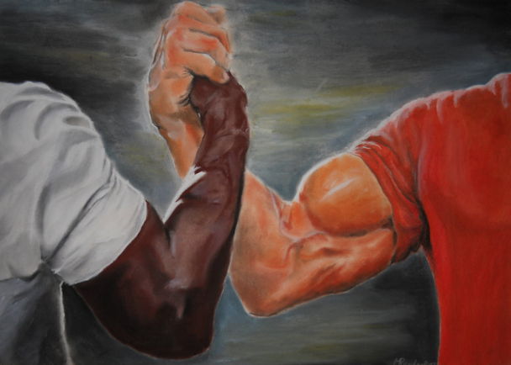
Course Perspective
About the course
Security flaws are design flaws
Limitations of the toolset / misuse of the toolset
How do we evaluate and prevent issues?
SSE
Software
Analysis
Software
Security

Slide 28
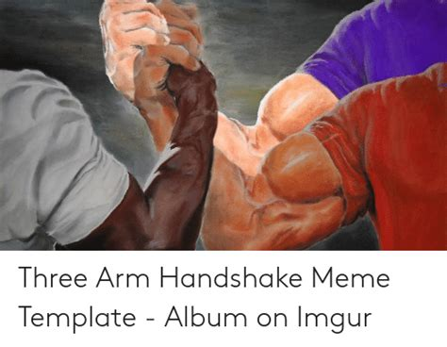
Course Perspective
About the course
Security flaws are design flaws
Limitations of the toolset / misuse of the toolset
How do we evaluate and prevent issues?
Software
Engineering
SSE
Software
Analysis
Software
Security

Slide 29

Basic Topic Breakdown
About the course
Secure Software Engineering
Analysis Techniques
Analysis Tools

Slide 30
Basic Topic Breakdown
About the course
Secure Software Engineering
secure software development lifecycle
tools like linters
Analysis Techniques
testing, fuzzing
control flow analysis, dependency analysis
points-to analysis, class hierarchy analysis
Analysis Tools
e.g. afl, LLVM

Slide 31
Today’s Roadmap
Orientation
About me
About you
About the course
Evaluating Evaluation

Slide 32

Analyzing Software
Evaluating Evaluation
How the heck do we tell what software is doing?
“Simpler question: how the heck do we tell what
software that we write is doing?
One answer: just be really, really careful when you write your code so you don’t make any mistakes
Software, basically
Historically insufficient answer

Slide 33
Program Understanding
Evaluating Evaluation
A major focus of this class is on treating programs as the target of an analysis
Target
Program
Analysis
Information about the target program
We’ll be quite generous in our notion of what an analysis is
Nevertheless, some details need to be considered…

Slide 34
lots of Other Problems
Evaluating Evaluation
How do we describe programs at all (the source code is a specification after all)
Perhaps we simply detect the presence/absence of a particular set of behaviors
“Does this program send personal data to the network?”
“Does this program allow a user to inject code and run it?”
How do we actually detect the presence/absence of a program property?
Not immediately obvious, with some very disheartening realities!

Slide 35
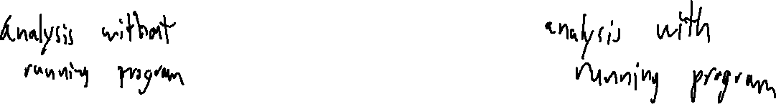
Forms of Analysis
Evaluating Evaluation
Static analysis
Dynamic Analysis

Slide 36
Testing as Analysis
Evaluating Evaluation
Most familiar form of program analysis:
Observation
Determine what is “supposed” to happen under some circumstance
Create an input specification and output specification
Run the program on the input specification, check against the output specification
Really good at proving the presence of some behavior!
Really easy to get started!
Really bad at proving the absence of a behavior!

Slide 37
Lecture END
[ ] Fill out the course entry survey
https://analysis.cool/survey
[ ] Read the syllabus
https://analysis.cool/677_syllabus.pdf
or
https://analysis.cool/777_syllabus.pdf
[ ] Sign up for Piazza

