Slide 1
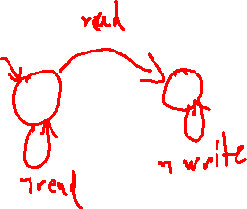
Exercise #23
Reference Monitors Review
Write your name and answer the following on a piece of paper
Give an example of a safety property that a reference monitor might enforce. How would an inline reference monitor work to enforce that safety property?

Slide 2
Exercise #23 Solution
Reference Monitors Review

Slide 3
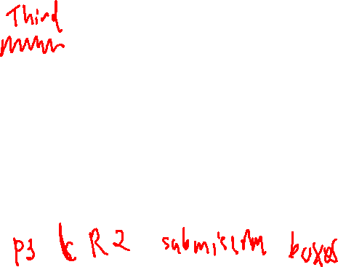
Administrivia and Announcements
Second reading assigned
- The original paper on CFI
Basically halfway through the semester
- Time to check in on how things are going

Slide 4
Control-Flow Integrity
EECS 677: Software Security Evaluation
Drew Davidson

Slide 5
Topic Context
Contemplated A form of attack, left with a hint of defenses

Slide 6

Last Time: Reference Monitors
Review: Last Lecture
Ensure Adherence to a Safety Policy
Halt the program is an action would violate the policy
Keep the program “on the rails”

Slide 7
Lecture Outline
Motivation
Implementation considerations
Practical manifestations

Slide 8
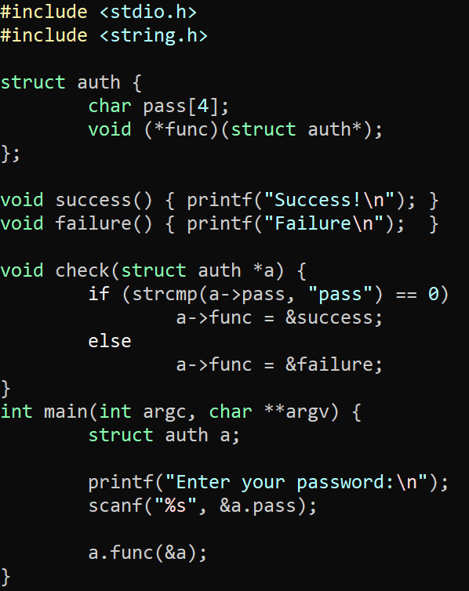
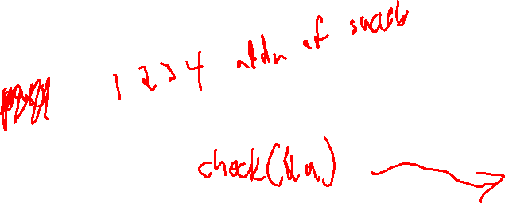
We know the Problem
motivation
Jumping where you shouldn’t
This certainly includes ROP
Might also involve other attacks

Slide 9
We know the Problem
motivation
Jumping where you shouldn’t
This certainly includes ROP
Might also involve other attacks
Look, no ret overwrite!

Slide 10
We know the Problem
motivation
Jumping where you shouldn’t
This certainly includes ROP
Might also involve other attacks
Look, no ret overwrite!

Slide 11
Lecture Outline
Motivation
Implementation considerations
Practical manifestations

Slide 12
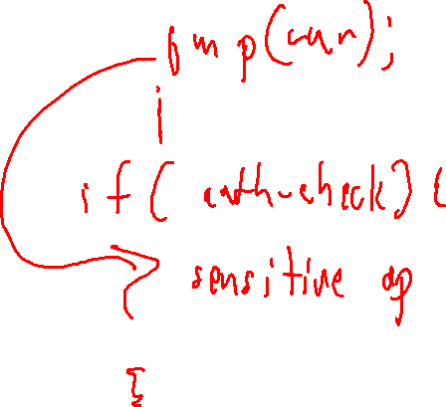
How to Implement?
Implementation Considerations
Naïve Approach:
Encode the entire ICFG into the program text

Slide 13
Lecture Outline
Motivation
Implementation considerations
Practical manifestations

Slide 14
Intel CET
Practical Manifestations
Control-Flow Enhancement Technology
Requires recompilation of software to support
Requires hardware support (!)
Scope
1) Prevent ret overwriting with a shadow stack

Slide 15
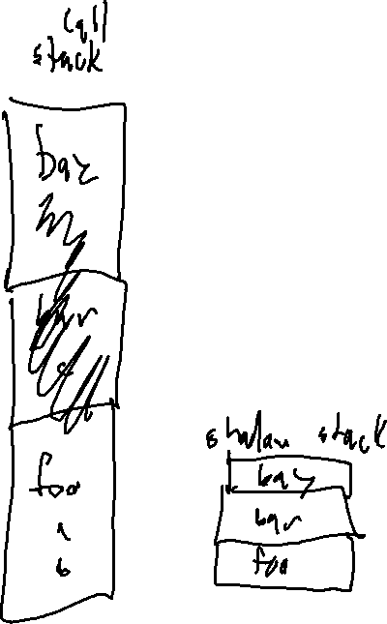
Intel CET
Practical Manifestations
Control-Flow Enhancement Technology
Requires recompilation of software to support
Requires hardware support (!)
Scope
1) (SHSTK) – Shadow Stack: Prevent ret overwriting with a shadow stack
2) (IBT) – Indirect Branch Tracking: Prevent indirect jumps into gadgets

Slide 16
Intel CET - Usage
Practical Manifestations
HW Support
On Linux, possible to check if the program has CET:
readelf –n <binary>
Should include the note
Displaying notes found in: .note.gnu.property
Owner Data size Description
GNU 0x00000020 NT_GNU_PROPERTY_TYPE_0
Properties: x86 feature: IBT, SHSTK
x86 ISA needed: x86-64-baseline
Intel 11th Gen or Later / AMD Ryzen 5000+
OS Support
Windows W10 19H1 (v1903)
Linux: kernel 6.6
Compiler Flags
gcc/llvm: -fcf-protection=full
Visual Studio: /CETCOMPAT

Slide 17
Intel CET
Practical Manifestations
CET Hardware changes
Altered semantics of the CALL and JMP
Moves a processor state machine into the WAIT_FOR_ENDBRANCH state
In WAIT_FOR_ENDBRANCH, next instruction must be the ENDBRANCH instruction
Added a new instruction at control-transfer targets
The new ENDBRANCH instruction
Backwards compatible

Slide 18
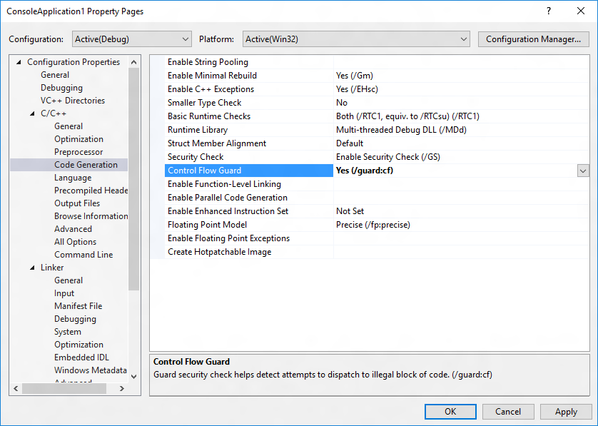
Microsoft Control Flow Guard
Practical Manifestations

Slide 19

Historical Detour
Practical Manifestations: MS Control-Flow Guard

Slide 20

Historical Detour
Practical Manifestations: MS Control-Flow Guard
Recall from last time…
ROP attacks considered harmful
How industry responded
MS CFG as a case study in a lot of interesting aspects of software security

Slide 21
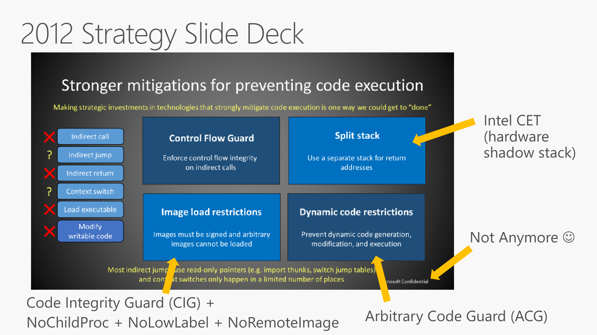
Historical Detour
Practical Manifestations: MS Control-Flow Guard
Source: https://github.com/Microsoft/MSRC-Security-Research/blob/master/presentations/
2018_02_OffensiveCon/The%20Evolution%20of%20CFI%20Attacks%20and%20Defenses.pdf

Slide 23
Historical Detour
Practical Manifestations: MS Control-Flow Guard
This is an interesting talk!
I’d recommend you watch it: https://www.youtube.com/watch?v=oOqpl-2rMTw
It comes with the historical burden of Control Flow guard
Widely-publicized issue that allowed it to be avoided

Slide 24
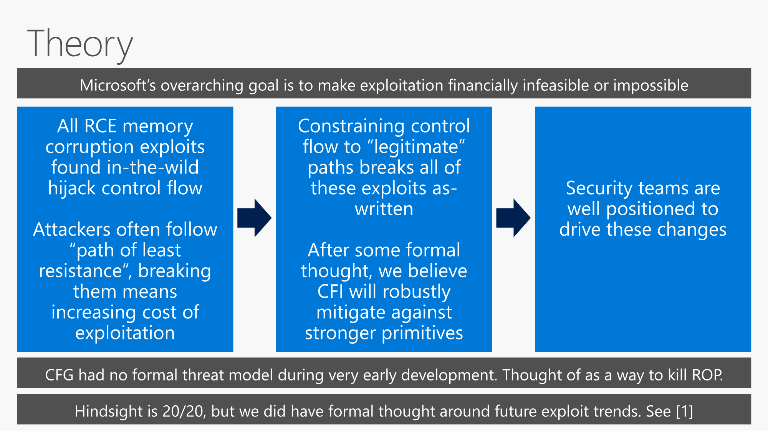

Slide 25
Historical Detour
Practical Manifestations: MS Control-Flow Guard
Control Flow guard has a historical burden
Widely-publicized issue that allowed it to be avoided
We’ll get to the actual workaround, but let’s talk about its impact

Slide 26

Historical Detour
Practical Manifestations: MS Control-Flow Guard

Slide 27
Control Flow Guard
Practical Manifestations
Details
Precision: call needs to be a valid function entry point
Enforcement: OS verifies indirect control transfer destinations via a table in protected memory
Protections
Protected destinations page in read-only memory
Read-only memory bit can be turned off by attacker ☹

Slide 28
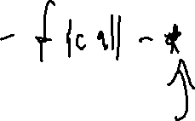
Clang’s CFI
Practical Manifestations
Details
Precision: call needs to match type signature
Enforcement: compiler-inserted checks

Slide 29
Wrap-up

