Slide 1
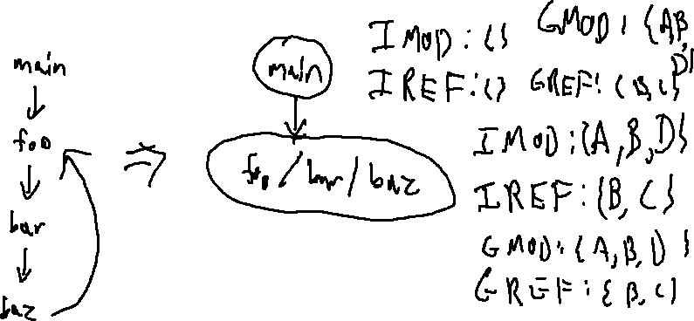
Exercise 19
Summary Function Review
Write your name and answer the following on a piece of paper
Compute GMOD / GREF for the below program
1: int A,B,C,D;
2: void baz(){
3: D = B;
4: A = C;
5: foo();
6: }
7: void bar(){
8: B = 2;
9: baz();
10: }
11: void foo(){
12: A = 1;
13: bar();
14: }
15: int main(){
16: foo();
17: foo();
18: }
19:

Slide 2
Exercise 19 Solution
Summary Function Review

Slide 3

Administrivia and Announcements

Slide 4
Call Targets
EECS 677: Software Security Evaluation
Drew Davidson

Slide 5
Last Time: Summary Functions
Review: Last Lecture
Can we over-Approximate a function’s effect without building the supergraph?
Motivation
Allows “quick”, modular analysis
Manifestations
GMOD/GREF (what variables are touched?)
Abstract transfer functions

Slide 6
More CompleX GmOD/GREF
Review: Last Lecture
main
{ }
Init all node GREF sets to their IREF sets
Init all call site GREF sets to empty
Put all nodes and call sites on a worklist
Iterate until the worklist is empty.
void main() {
S1: call a(v1)
}
main
IREF = { }
S1
S1
{ }
void a( f1 ) {
S2: call b(v2, v3)
S3: call b(v4, v5)
}
a
IREF = { }
S2 S3
a
{ }
S2
{ }
Function Node n:
Recompute GREF = U GREF(s) => s in n U IREF(n)
If updated, put all calls sites TO n on worklist
Call Site s:
GREF = GREF(callee m), formals mapped to actuals
If updated, add function CONTAINING s to worklist
S3
{ }
void b( f2, f3 ) {
print f3;
S4: call b(g1, g2)
}
b
IREF = {f3}
S4
b
{ f3 }
S4
{ }

Slide 7
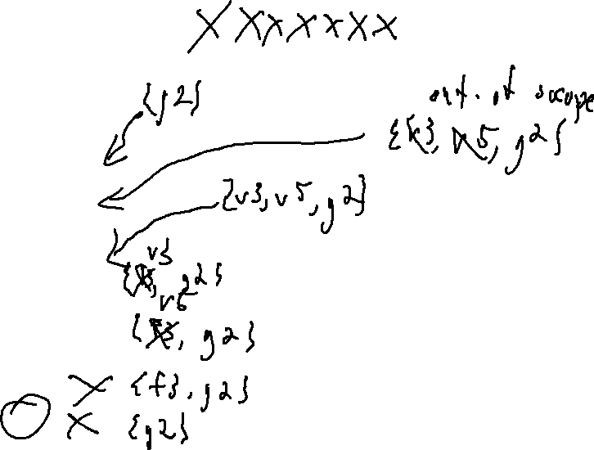
More CompleX GmOD/GREF
Review: Last Lecture
Function Node n:
Recompute GREF = U GREF(s) => s in n U IREF(n)
If updated, put all calls sites TO n on worklist
Call Site s:
GREF = GREF(callee m), formals mapped to actuals
If updated, add function CONTAINING s to worklist
Worklist: { main, S1, a, S2, S3, b, S4 }
void main() {
S1: call a(v1)
}
main
IREF = { }
S1
main
{ }
S1
{ }
void a( f1 ) {
S2: call b(v2, v3)
S3: call b(v4, v5)
}
a
IREF = { }
S2 S3
a
{ }
S2
{ }
S3
{ }
void b( f2, f3 ) {
print f3;
S4: call b(g1, g2)
}
b
IREF = {f3}
S4
b
{ f3 }
S4
{ }

Slide 8
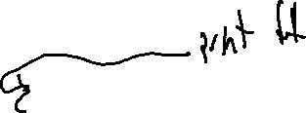
More CompleX GmOD/GREF
Review: Last Lecture
Function Node n:
Recompute GREF = U GREF(s) => s in n U IREF(n)
If updated, put all calls sites TO n on worklist
Call Site s:
GREF = GREF(callee m), formals mapped to actuals
If updated, add function CONTAINING s to worklist
void main() {
S1: call a(v1)
}
main
IREF = { }
S1
main
{ g2 }
S1
{ g2 }
void a( f1 ) {
S2: call b(v2, v3)
S3: call b(v4, v5)
}
a
IREF = { }
S2 S3
a
{ g2, v3, v5 }
S2
{ v3, g2 }
S3
{ v5, g2 }
void b( f2, f3 ) {
print f3;
S4: call b(g1, g2)
}
b
IREF = {f3}
S4
b
{ f3, g2 }
S4
{ g2 }

Slide 9
More CompleX GmOD/GREF
Review: Last Lecture
Function Node n:
Recompute GREF = U GREF(s) => s in n U IREF(n)
If updated, put all calls sites TO n on worklist
Call Site s:
GREF = GREF(callee m), formals mapped to actuals
If updated, add function CONTAINING s to worklist
main
{ }
void main() {
S1: call a(v1)
}
main
IREF = { }
S1
S1
{ }
void a( f1 ) {
S2: call b(v2, v3)
S3: call b(v4, v5)
}
a
IREF = { }
S2 S3
a
{ g2, v3, v5 }
S2
{ v3, g2 }
S3
{ v5, g2 }
void b( f2, f3 ) {
print f3;
S4: call b(g1, g2)
}
b
IREF = {f3}
S4
b
{ f3, g2 }
S4
{ v5, g2 }

Slide 10
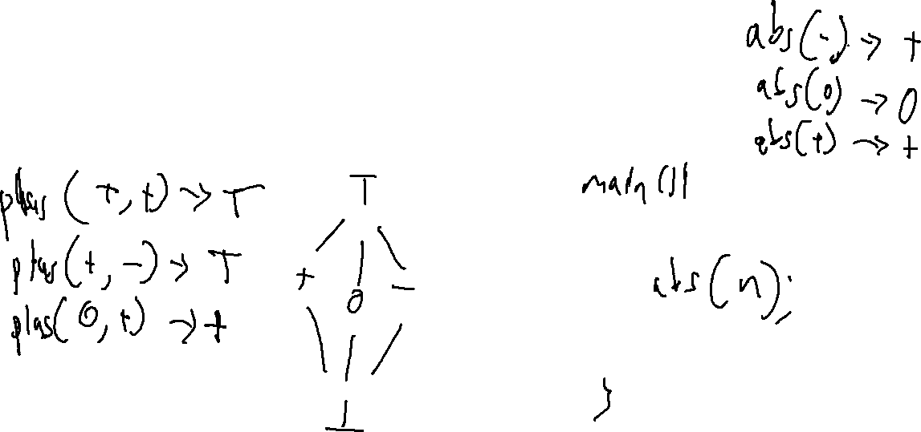
Abstract Transfer Functions
Review: Last Lecture
Can we over-Approximate a function’s effect without building the supergraph?

Slide 11

Overview
How do we figure out control transfer targets in the first place?

Slide 12
Lecture Outline
Dynamic Dispatch
Algorithms

Slide 13

Dynamic Dispatch
A history of Computing
1: class A{
2: public A f(){ return new C(); }
3: public String g(){ return "A"; }
4: };
5: class B : public A{
6: public String g(){ return "B"; }
7: };
8: class C : public A{
9: public String g(){ return "C"; }
10: };
11: class D : public A{
12: public String g(){ return "D"; }
13: };
14: class Driver {
15: public void main(String[] args){
16: A[] aArr = {new A(), new B()};
17: for (A a : aArr){
18: A res = a.f();
19: print(a.g());
20: print(res.g());
21: }
22: }
23: };
A.init
A.f
Driver.main
A.g
16
B.init
18
19
B.g
20
C.init
C.g
C.init
D.g

Slide 14

Dynamic Dispatch: Gets Complicated!
A history of Computing

Slide 15
Dynamic Dispatch: Gets Complicated!
A history of Computing
Direct Calls
Not so bad
Indirect Calls
Quite a bit harder: multiple targets possible!

Slide 16
Dynamic Dispatch: Gets Complicated!
A history of Computing
1: class A{
2: public A f(){ return new C(); }
3: public String g(){ return "A"; }
4: };
5: class B : public A{
6: public String g(){ return "B"; }
7: };
8: class C : public A{
9: public String g(){ return "C"; }
10: };
11: class D : public A{
12: public String g(){ return "D"; }
13: };
14: class Driver {
15: public void main(String[] args){
16: A[] aArr = {new A(), new B()};
17: for (A a : aArr){
18: A res = a.f();
19: print(a.g());
20: print(res.g());
21: }
22: }
23: };
Direct Calls
Not so bad
Indirect Calls
Quite a bit harder: multiple targets possible!

Slide 17
Lecture Outline
Dynamic Dispatch
Algorithms

Slide 18
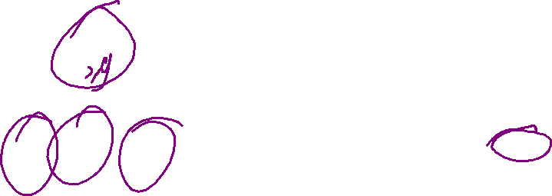
Class Hierarchy Analysis (CHA)
A history of Computing
1: class A{
2: public A f(){ return new C(); }
3: public String g(){ return "A"; }
4: };
5: class B : public A{
6: public String g(){ return "B"; }
7: };
8: class C : public A{
9: public String g(){ return "C"; }
10: };
11: class D : public A{
12: public String g(){ return "D"; }
13: };
14: class Driver {
15: public void main(String[] args){
16: A[] aArr = {new A(), new B()};
17: for (A a : aArr){
18: A res = a.f();
19: print(a.g());
20: print(res.g());
21: }
22: }
23: };
Consider the Safe over-approximation
Treat call as declared type, or any subtype
Object
Driver
A
main
f
B
C
D
g
g
g

Slide 19
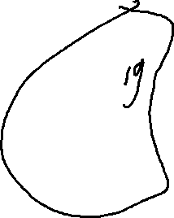
Rapid Type Analysis (RTA)
A history of Computing
1: class A{
2: public A f(){ return new C(); }
3: public String g(){ return "A"; }
4: };
5: class B : public A{
6: public String g(){ return "B"; }
7: };
8: class C : public A{
9: public String g(){ return "C"; }
10: };
11: class D : public A{
12: public String g(){ return "D"; }
13: };
14: class Driver {
15: public void main(String[] args){
16: A[] aArr = {new A(), new B()};
17: for (A a : aArr){
18: A res = a.f();
19: print(a.g());
20: print(res.g());
21: }
22: }
23: };
Refinement over CHA
Consider only initialized classes
Consider only reachable code
Object
Driver
A
main
f
B
C
D
g
g
g

Slide 20
CHA
A history of Computing
1: class A{
2: public A f(){ return new C(); }
3: public String g(){ return "A"; }
4: };
5: class B : public A{
6: public String g(){ return "B"; }
7: };
8: class C : public A{
9: public String g(){ return "C"; }
10: };
11: class D : public A{
12: public String g(){ return "D"; }
13: };
14: class Driver {
15: public void main(String[] args){
16: A[] aArr = {new A(), new B()};
17: for (A a : aArr){
18: A res = a.f();
19: print(a.g());
20: print(res.g());
21: }
22: }
23: };
Refinement over CHA
Consider only initialized classes
Consider only reachable code
Object
Driver
A
main
f
B
C
D
g
g
g

Slide 21
Rapid Type Analysis (RTA)
A history of Computing
RTA = call graph of functions (initially edgeless)
CHA = call graph via class hierarchy analysis
W = worklist
W.push(main)
while not W.empty:
M = pop W
T = allocated types in M
T = T U allocated types in RTA callers of M
foreach callsite(C) in M
if C is statically-dispatched:
add edge C to C’s static target
else:
M’ = methods called from M in CHA
M’ = M’ intersect functions declared in T or T-supertypes
add edge from M to each M’
W.pushAll(M’)

Slide 22
Rapid Type Analysis (RTA)
A history of Computing
An unsound analysis!
1: public static Object gbl;
2:
3: public static void main(String[] args){
4: foo();
5: bar();
6: }
7:
8: public static void foo(){
9: Object o = new A();
10: gbl = o;
11: }
12:
13: public static void bar(){
14: gbl.toString();
15: }
RTA will not include an edge from bar to toString because neither bar or its callers (main) allocated any instance that toString could be called on

Slide 23
Rapid Type Analysis (RTA)
A history of Computing
An unsound analysis!
1: public static Object gbl;
2:
3: public static void main(String[] args){
4: Object o = foo();
5: bar(o);
6: }
7:
8: public static Object foo(){
9: return new A();
10: gbl = o;
11: }
12:
13: public static void bar(Object o){
14: o.toString();
15: }
Call edge to A’s toString missing!
Neither bar or its callers (main) allocated a type of A

Slide 24
Beyond RTA
A history of Computing
Assumptions to strengthen analysis
Type safety?
Might not be a safe assumption
FTA adds the constraint that any method that reads from a field can inherit the field-compatible allocated types of any method that could write to that field.
MTA adds the constraint that types allocated in a method and then passed to a method through a parameter should be compatible with the called method’s parameter types. MTA also adds the constraint that the return type of each called method be added to the set of allocated types.
XTA: add both the constraints of MTA an FTA

Slide 25
Comparing Call Graph Analyses
A history of Computing
CHA
Complete
Edge-finder
RTA
Precision
Efficiency
FTA
MTA
XTA

Slide 26
Wrap-up

